Slide 1

Authoring ARM Templates
Lab Deck
Richard Cheney
@RichCheneyAzure
Deck:
Ben Coleman
Nov 2017

Slide 2
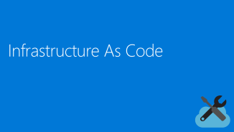
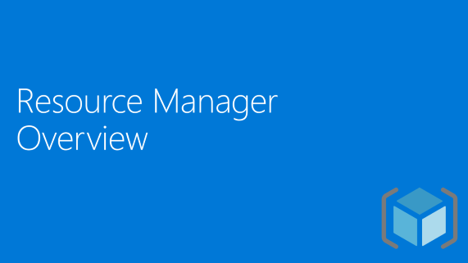




Topics

Slide 3

Resource Manager Overview
Notes:
NOTE - If presenting this deck, the following section goes deeper into ARM, do not present these slides unless you are running a hands on workshop or training lab on the topic

Slide 4
WHAT IS ARM
Azure Resource Manager sits at the heart of Azure as the control plane for managing the lifecycle of every resource in the platform.
Azure Resource Manager consists of a common API surface, consistent tooling and templating mechanisms
Notes:
A summary of what Azure Resource Manager does and why it exists

Slide 5

HISTORY
Azure Service Manager (ASM aka ‘Classic’)
Legacy way to deploy and manage applications in Azure
Classic portal
PowerShell / CLI (default mode)
No templating, no grouping
2014
Azure Resource Manager (ARM)
Modern way to deploy and manage applications in Azure
Production Portal
PowerShell / Cross platform CLI
REST API
Idempotent and incremental deployments
Use Azure Resource Groups as unit of management
Templates and declarative orchestration
Infrastructure As Code approach
Notes:
ARM was introduced in 2014 and replaces the legacy API (called ASM - Azure Service Manager)
The legacy API goes hand in hand with the classic portal - and is slowly being phased out
All work in Azure now should be done via ARM for all the reasons shown here

Slide 6



RESOURCE GROUP
Resource
Group
1
container for multiple resources
2
resources exist in one* resource group
3
resource groups can span regions
4
resource groups can span services
*and only one
Notes:
All resources in ARM must reside in a resource group.
Groups are a logical construct to hold resources, they are not a resource themselves.

Slide 7



ORGANIZE
my-app
my-app-prod
webapp storage db
my-app-test
OR
OR
all-webapps
all-db
my-app-dev
all-storage
Notes:
How you organize resources across groups is up to you, use whatever grouping makes sense based on the application, the lifecycle of those resources or other management / organizational constraints
For example this web application has a three resource, we can group those together - so the resource group represents “the app”
OR
We could also split by resource type e.g. all dbs and all storage go into groups - this way certain teams or individuals can have permissions to those resource types without giving everyone access
OR
A logical approach is to group by environment so all prod resources for that app go together, all dev and all test are grouped as environments

Slide 8




MANAGE
Tagging
my-app-resgroup
Role Based
Access Control
webapp storage db
Policies
manage groups not individual resources
Locks
Notes:
The key thing about groups as they provide the core unit of management in Azure, at the group level you can apply:
Tags: key value pairs to help with billing and other identification of resources, letting you attach your own metadata to a resource group
RBAC: control who can see, and interact with resources with a fine grained RBAC roles and operations model, linked to Azure AD
Policies: Assign resource polices to enforce rules such as permitted types of resources, resource names, regions, VM sizes and other attributes you want to govern
Locks: Prevent modification and deletion of resources

Slide 9
MANAGE
Role Based
Access Control
Tagging
Policies
Locks
Assign metadata to resources
Multiple tags per group or resource
Used with billing, reporting and automation
Control access to resources
Fine grained roles and operations
Backed by Azure AD
Govern how resources are used with rules
Apply restrictions on type, region, size, name, etc
Global or group level
Protect live resources
Prevent accidental changes with RBAC
Lock against deletion or modification
Notes:
The key thing about groups as they provide the core unit of management in Azure, at the group level you can apply:
Tags: key value pairs to help with billing and other identification of resources, letting you attach your own metadata to a resource group
RBAC: control who can see, and interact with resources with a fine grained RBAC roles and operations model, linked to Azure AD
Policies: Assign resource polices to enforce rules such as permitted types of resources, resource names, regions, VM sizes and other attributes you want to govern
Locks: Prevent modification and deletion of resources

Slide 10
Resource Providers & Types
Format:
{ProviderName}/{ResourceType}
Resource Providers, examples:
Microsoft.Compute
Microsoft.Network
Microsoft.Web
Resource Types, examples:
Microsoft.Compute/disks
Microsoft.Compute/virtualMachines
Microsoft.Network/publicIPAddresses
Microsoft.Network/virtualNetworks/subnets
Microsoft.Web/sites
Note.
There are over 100 resource providers
and over 700 resource types
$ az provider list -o table
$ az provider show -n Microsoft.Compute
Notes:
Details on resource providers and types, resource providers are a key aspect of ARM, and can be plugged into the Azure platform either by Microsoft or 3rd parties.
Every resource has both a provider and a type

Slide 11
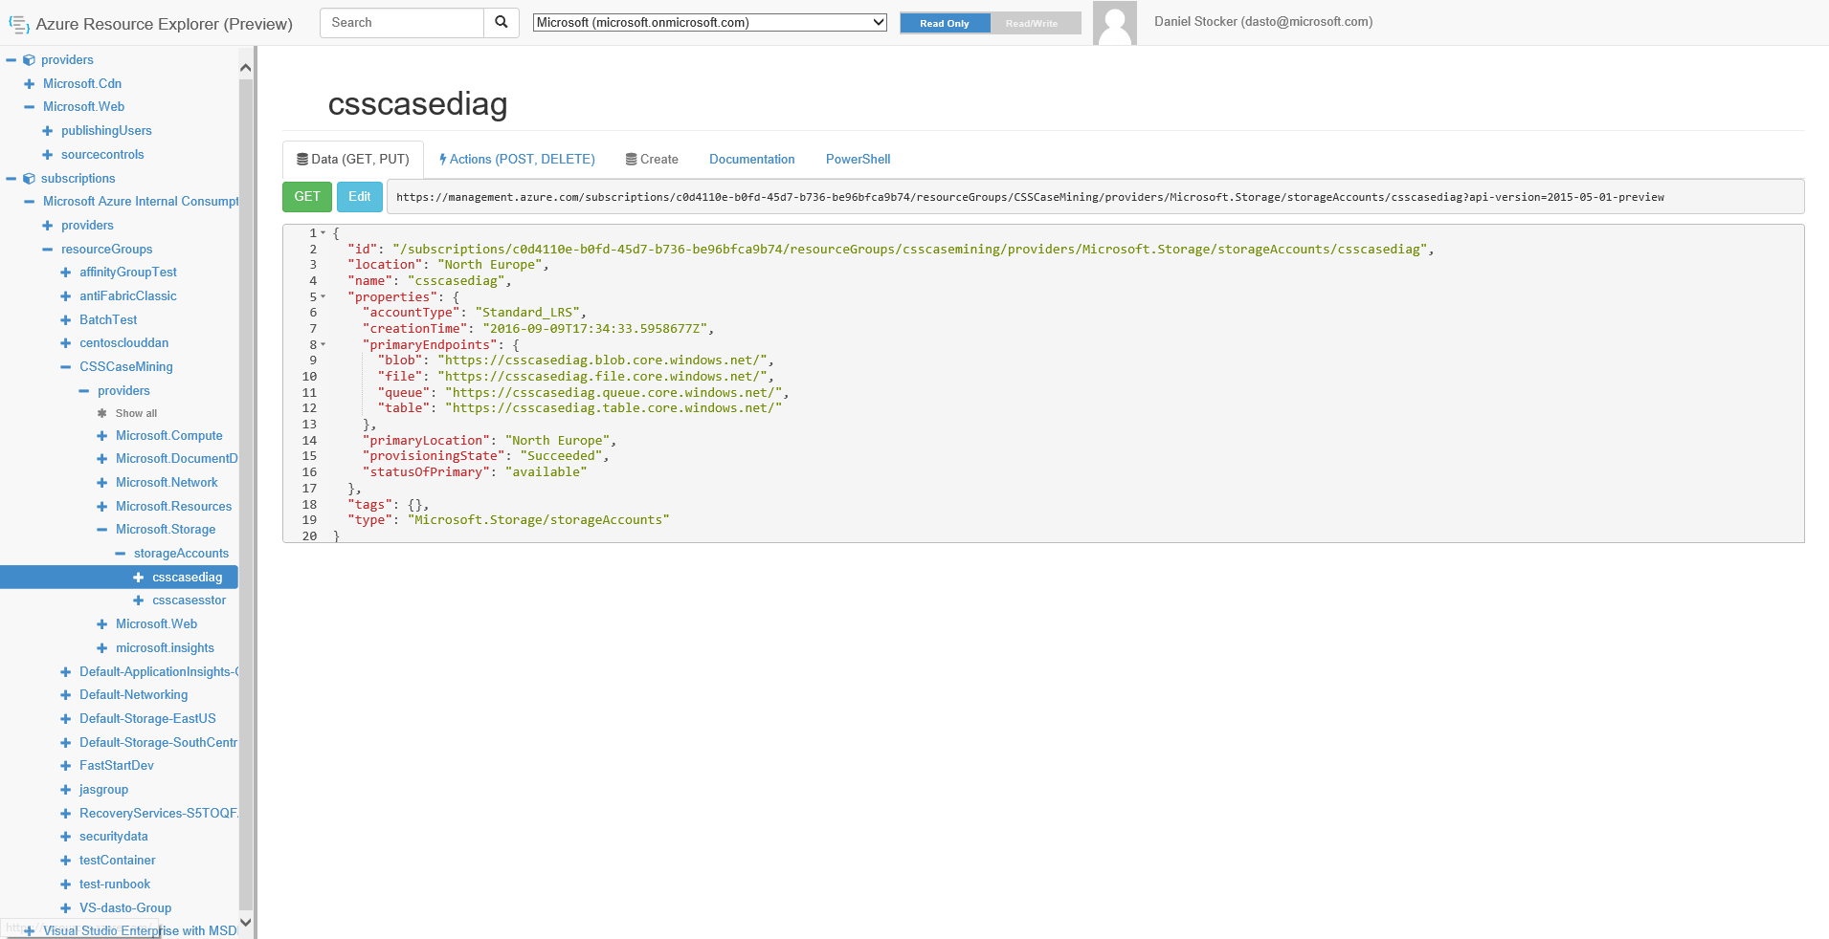
Azure Resource Explorer
https://resources.azure.com/
Notes:
Resource explorer is a great way to understand more about ARM, you can inspect resources and their properties - which can give you ideas of the properties settable in your templates
You can also edit resources and make advanced changes to them, bypassing the portal, but proceed with caution!

Slide 12

Azure Resource Ids
/subscriptions/c000110d-b000-4000-b000-b000bf000b00/resourceGroups/myGroup/providers/Microsoft.Storage/storageAccounts/myStore
GLOBALLY
UNIQUE
URI
Variable elements
Azure Subscription GUID
Resource group name (e.g. myGroup)
Resource name (e.g. myStore)
Warning!
Nerdy Stuff
Resource section
Resource provider
Resource type (plus optional sub-type)
Notes:
Every resource in Azure has an ID, but this is not some integer value or a GUID.
It’s a form of URN - a string made up of several parts separated by forward slashes.
This complete string contains enough information to uniquely identify any resource in the whole of Azure

Slide 13

Infrastructure As Code
Notes:
NOTE - If presenting this deck, you can stop here if all you needed is a basic intro. The following section goes into a little more depth on the topic of templates and infrastructure as code

Slide 14
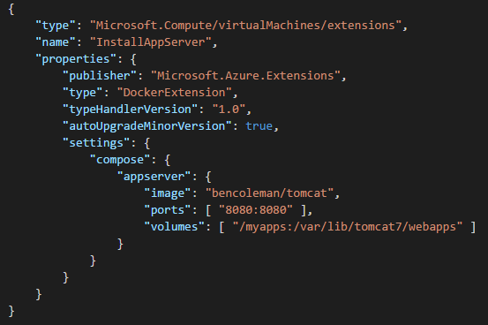
TEMPLATING
1
Specify resources & dependencies
ARM Template
SQL-A
2
Declarative - desired state
{ "parameters": {}, "variables": {}, "resources": [ { type: "Microsoft.Compute/virtualMachines" } ], "outputs": {} }
Website
[SQL CONFIG] VM (2x)
3
Repeated & consistent deployments
4
Incremental deployments - idempotent
5
JSON based description
DEPENDS ON SQL
DEPENDS ON SQL
SQL - A
Website
Virtual
Machines
INFRASTRUCTURE AS CODE
SQLCONFIG
Notes:
Templates are a key capability of ARM allowing you to use the now common infrastructure as code approach
ARM templates allow you to specify the resources you want deployed and automate that deployment
Templates are declarative and represent *desired state*
Templates are idempotent so you can redeploy safely over existing resources, any changed parameters in your template will be applied to existing resources as necessary, e.g. want to scale up - change the instance count in your template and re-deploy

Slide 15
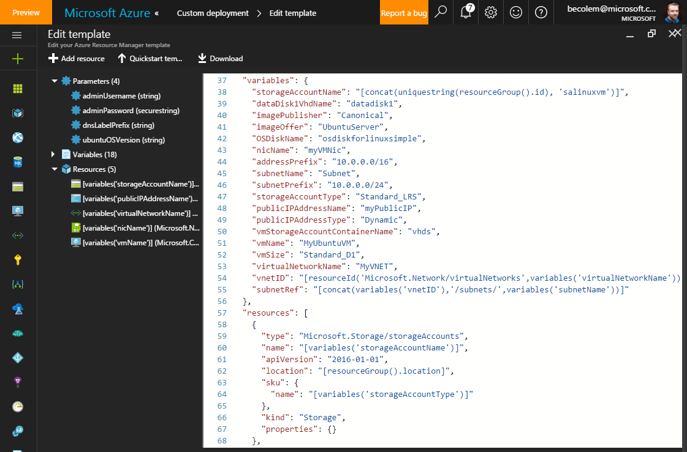
Notes:
Editing a template in the portal

Slide 16
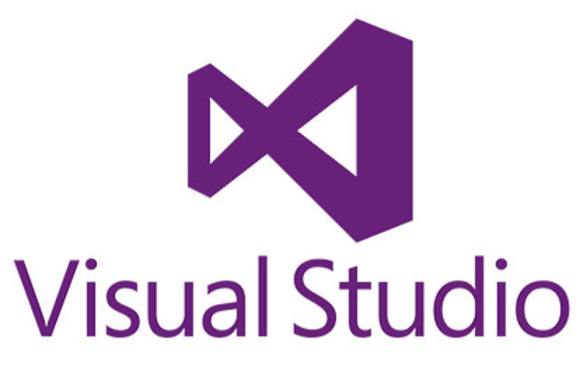



AUTHORING
1
Visual Studio 2015
2
Visual Studio Code (cross platform)
Visual Studio Code
3
Azure Portal
4
Exporting existing resources
5
Any code/text editor with JSON support
{ }
Create automation
script (export)
Portal template
management
Full reference- aka.ms/armref
Notes:
Lots of ways to author templates, they are standard JSON documents
The Azure portal lets you “export” to existing resources and capture a template
Github has many templates and is the defacto collection of templates - and good to learn from

Slide 17






DEPLOYING
1
Azure Portal
2
PowerShell
3
Azure CLI (cross platform)
4
Visual Studio / Visual Studio Code
5
Visual Studio Team Services (CI / CD)
6
REST API
7
SDKs (.NET, Java, Node.js, Python, Ruby, etc.)
8
Octopus, Ansible, Chef, Puppet
9
‘Deploy to Azure’ HTML button
Notes:
There are LOTS of ways to deploy resources via ARM and templates, this is some of the tools and mechanisms available

Slide 18
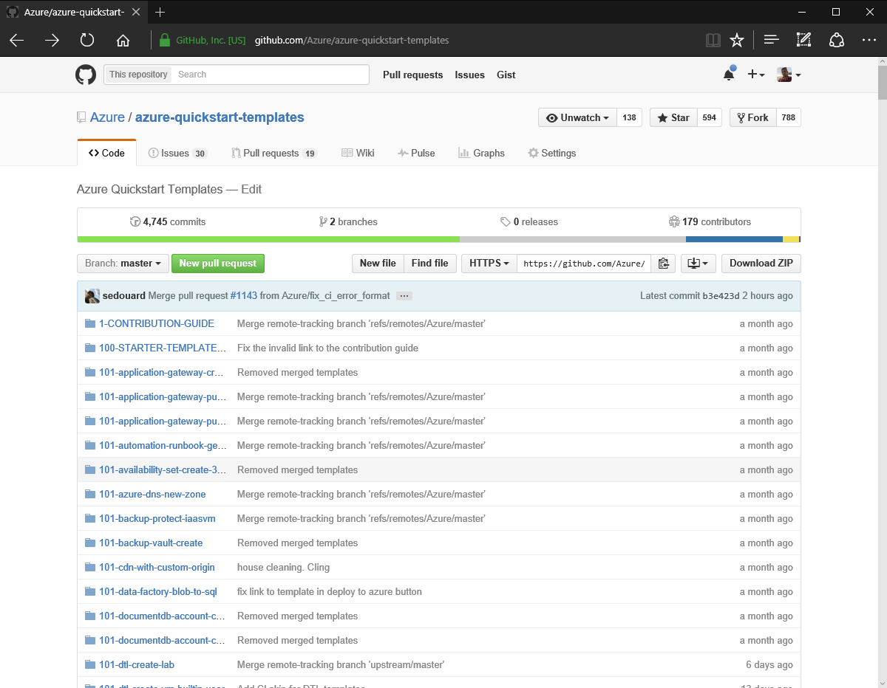
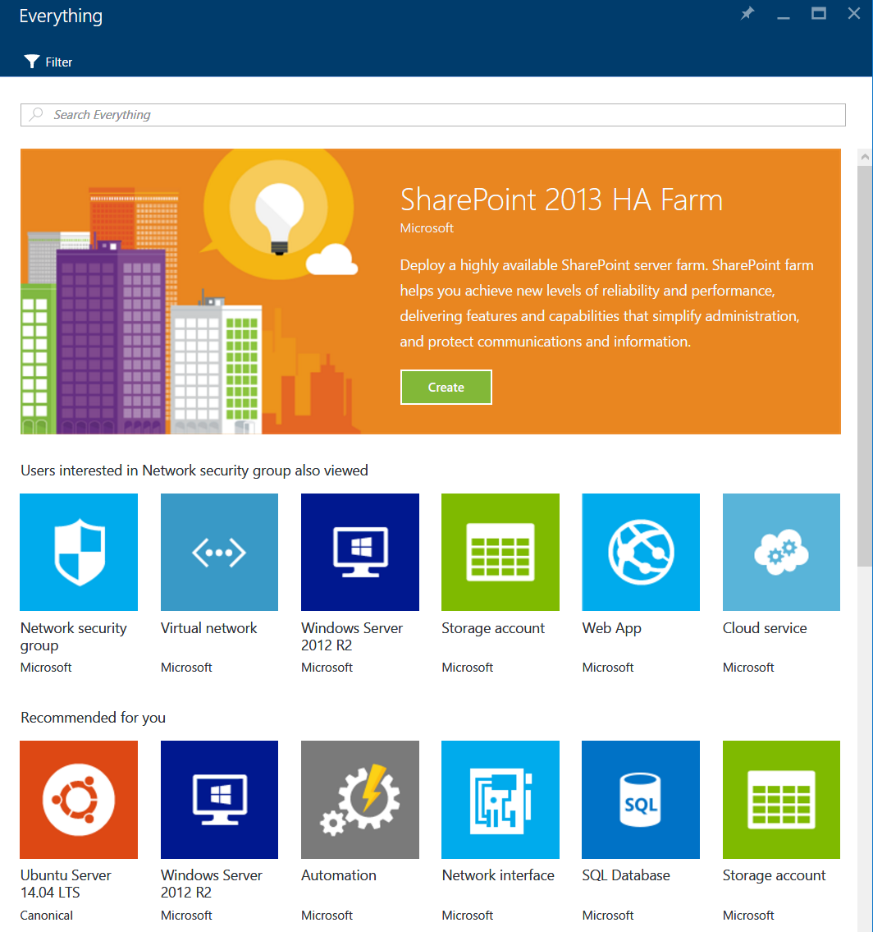
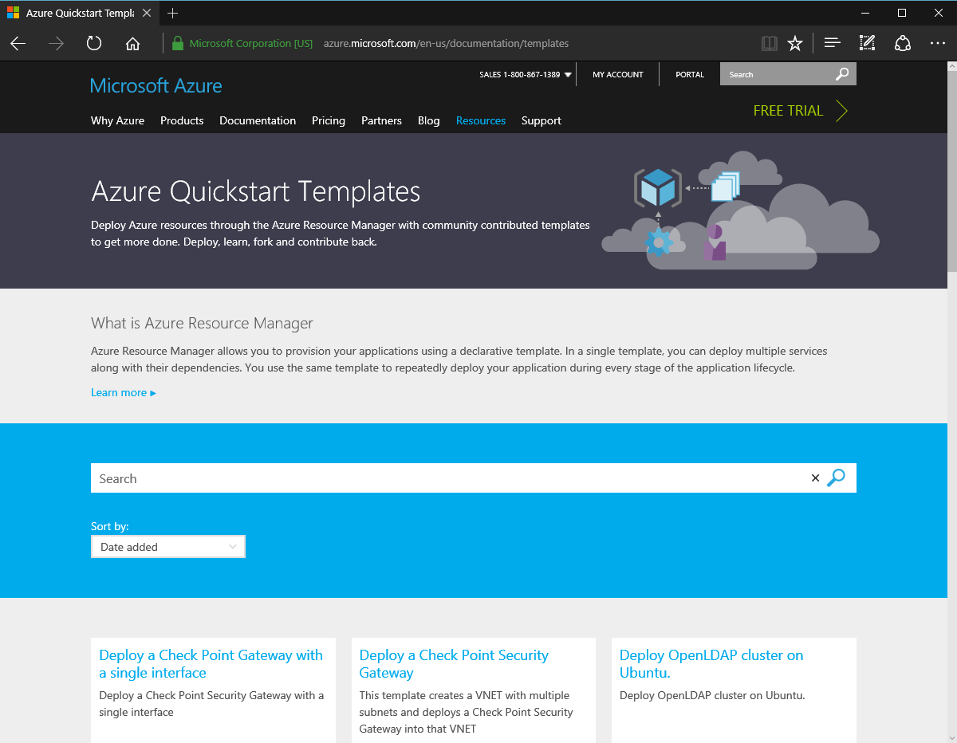
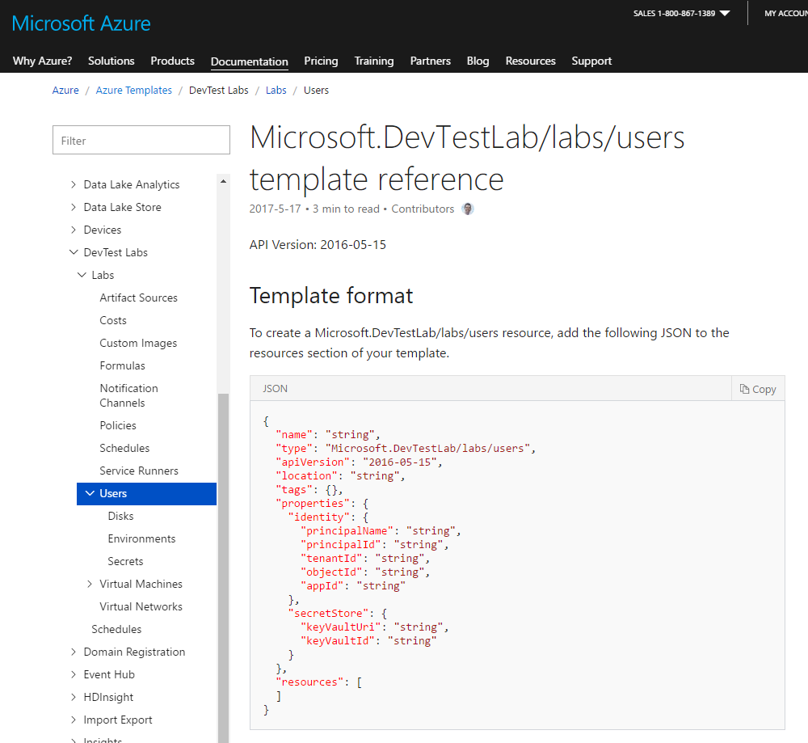
ARM RESOURCES
Github Quickstart
ARM Template Full Reference
Azure.com template library
Azure Marketplace
https://github.com/Azure/azure-quickstart-templates
https://docs.microsoft.com/en-gb/azure/templates/
https://azure.microsoft.com/en-gb/resources/templates/
https://azuremarketplace.microsoft.com/
Notes:
These are some key online resources for ARM templates

Slide 19















ARM TOOLING AND SDKs
Use whichever tools you are comfortable with
Visual Studio
Visual Studio Code
PowerShell
Cross Platform CLI
Config Management
Tools
Language SDKs
ARMClient
REST API
https://github.com/projectkudu/ARMClient
https://docs.microsoft.com/en-gb/azure/#pivot=sdkstools
Notes:
As we touched on during the deploying slide - there are a many libraries, tools and SDKs to allow you to use ARM, both opensource and Microsoft
The cross platform CLI is written in Python works on Windows, Linux and OSX it is also open source

Slide 20
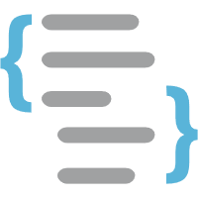
Deeper Dive
Notes:
NOTE - If presenting this deck, the following section goes deeper into ARM, do not present these slides unless you are running a hands on workshop or training lab on the topic

Slide 21
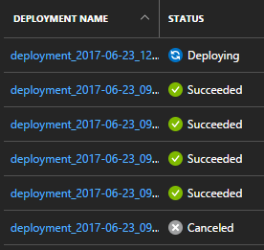
Templates Basics
Note. You can call these files anything you like
Template file, JSON - e.g. azuredeploy.json
Main file, declares resources, input parameters, etc
Parameter file, JSON - e.g. azuredeploy.parameters.json
Optional file, provides values for the all parameters at deploy time
Deploy into a resource group (groups are not defined in the template)
Azure CLI
$ az group deployment create -g "MyGroup" --template-file "azuredeploy.json" --parameters "@azuredeploy.parameters.json"
PowerShell
$ New-AzureRmResourceGroupDeployment -ResourceGroupName "MyGroup" -TemplateFile "azuredeploy.json" -TemplateParameterFile "azuredeploy.parameters.json"
Notes:
ARM Templates are Azure’s primary approach to infrastructure as code.
A template can define any number or type of resources, declare how they are to be built, their properties, the order they should be deployed in.
The following slides dig deeper into ARM templates

Slide 22
General Template Structure
Schema (required)
Content Version (required)
Parameters
Variables
Resources (array)
Outputs
Best practises for template
development
Full documentation
{
"$schema": "http://schema.management.azure.com/schemas/2015-01-01/deploymentTemplate.json#",
"contentVersion": "1.0.0.0",
"parameters": { },
"variables": { },
"resources": [ ],
"outputs": { }
}
Notes:
This is the basic form of am ARM template
Outputs, Parameters and Variables are optional, a template much have at least one resource

Slide 23
Parameters vs. Variables
Parameters are exposed to the user of the template as inputs they can provide.
Values are passed to the template via a parameter file or from the command line
Variables are used internally by the template for values you wish to use in several places or to prevent hard-coding
"vmUserName": {
"type": "string",
"defaultValue": “adminuser",
}
"appPlanName": "app-service-plan",
"subnet": "10.0.100.0/24",
Notes:
The difference between a parameter and a variable may not be apparent when first using templates, this describes the differences

Slide 24
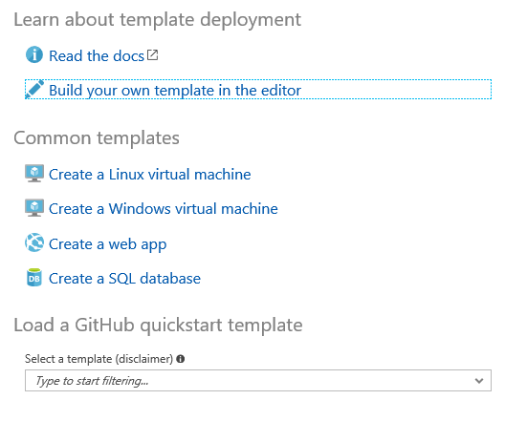
Editing Templates - Advice
Visual Studio 2017 has a UI and JSON outline view making template editing & deployment easy, but VS2017 can be overkill for general template work
Visual Studio Code is a lighter weight option with great support for JSON, and has extensions such as Azure Resource Manager Tools and ARM snippets to help with development
The Azure portal has an editor built in which is not well known. This supports loading templates from the Github quickstart repo, importing & exporting files and a UI for adding certain resources to your template
https://portal.azure.com/#create/Microsoft.Template
Notes:
Some advice on how to edit & create templates

Slide 25
Template Functions
Array and object functions
Comparison functions
Deployment value functions
Resource functions
Numeric functions
String functions
Note.
Functions are enclosed in braces
[ ] to distinguish them from literal
string values in JSON.
https://docs.microsoft.com/en-us/azure/azure-resource-manager/resource-group-template-functions
Notes:
Functions are used extensively in templates even when accessing parameters and variables.
There’s now a LOT of different functions available for range of scenarios - this slide is just introducing the concept

Slide 26
Template Functions - Commonly Used
parameters()
variables()
Reference template variables & parameters
"name": "[variables('vnetName')]",
"size": "[parameters('vmSize')]",
resourceGroup()
resourceId()
reference()
Reference other resources or containing group
"location": "[resourceGroup().location]",
"dependsOn": ["[resourceId('Microsoft.Sql/servers', parameters('sqlServerName'))]"]
Get keys & secrets from resources
listKeys()
listKeys(variables('storageAcctName'),'2015-05-01-preview').key1)]"
Concat strings and functions together
"nicName": "[concat(parameters('vmName'), '_nic')]",
concat()
Notes:
Details on ARM functions, and examples of commonly used functions

Slide 27



Resource Dependencies
For speed ARM will deploy resources in parallel where it can, but…
You can’t create a VM without a NIC to assign to it
BUT you can’t create a NIC without a VNET to put it in
Solution! - dependencies…
dependsOn is an array of resource ids
Azure resolves the correct deployment order at deployment time
depends-on
depends-on
"dependsOn": [
"[resourceId('Microsoft.Network/networkInterfaces/', variables('nicName'))]"],
"dependsOn": [
"[resourceId('Microsoft.Network/virtualNetworks/', variables('vnetName'))]"],
"type": "Microsoft.Network/virtualNetworks",
Notes:
Dependencies between resources are common - where the output or existence of one resource is needed for another
ARM templates let you define dependencies using the dependsOn statement

Slide 28
Template Outputs
Output information about the resources deployed such as IP addresses and keys, etc. Outputs are always optional
concat elements together to provide friendly URLs etc
Top-Tip. If you don’t know what properties you can use, just output the whole object using reference, and examine the result e.g.
"storageAccountKey": {
"type": "string",
"value": "[listKeys(variables('storageAcctName'), '2015-05-01-preview').key1]"
}
"tomcat_url": {
"type": "string",
"value": "[concat('http://', reference(variables('tomcatIpName')).dnsSettings.fqdn, '/')]"
}
“storeAcctObject": {
"type": "object",
"value": "[reference(variables('storageAcctName'))]"
}
Notes:
Output are optional to add to your template, but sometimes helpful.
You can see the output of a deployment on the command like when using PowerShell or the CLI, and also in the portal

Slide 29

Resource Summary
Quickstart templates - https://github.com/Azure/azure-quickstart-templates
ARM full reference http://aka.ms/armref
Azure published templates - https://azure.microsoft.com/en-gb/resources/templates/
Resource explorer - https://resources.azure.com/
Resource Manager main docs - https://docs.microsoft.com/en-us/azure/azure-resource-manager/
ARM template best practices - https://aka.ms/armbest
ARM template main docs - https://docs.microsoft.com/en-us/azure/templates/
Template functions reference - https://docs.microsoft.com/en-us/azure/azure-resource-manager/resource-group-template-functions
Visual Studio Code - https://code.visualstudio.com/
Azure Portal template editor - https://portal.azure.com/#create/Microsoft.Template
ARM Client tool - https://github.com/projectkudu/ARMClient

